Slide 1
CS 106A, Lecture 25 Life After CS 106A, Part 1

Slide 2
Plan for today
Announcements
Life after the ACM Libraries
Life after Java
Life after PC programs
Internet applications
Mobile applications
Tomorrow: Intro to Machine Learning!

Slide 3
CS 106A Lunches!
Wednesday, 8/16
Thursday, 8/17
(no lecture those days)

Slide 4
Anonymous Questions
What is your music taste?
How did you know you wanted to pursue CS?
What was your first code for?

Slide 5
Plan for today
Announcements
Life after the ACM Libraries
Life after Java
Life after PC programs
Internet applications
Mobile applications

Slide 6
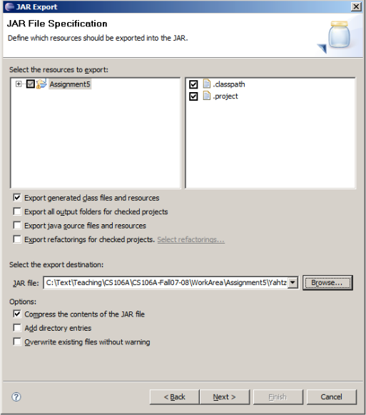
Export to JAR
JAR: Java Archive. A compressed binary of a Java program.
The typical way to distribute a Java app as a single file.
Essentially just a ZIP file with Java .class files in it.
Making a JAR of your project in Eclipse:
File → Export ... → Java → Runnable JAR File
see handout on course web site

Slide 7
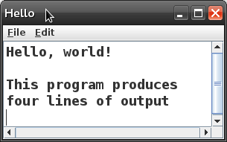
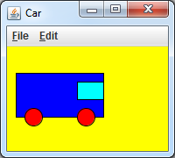
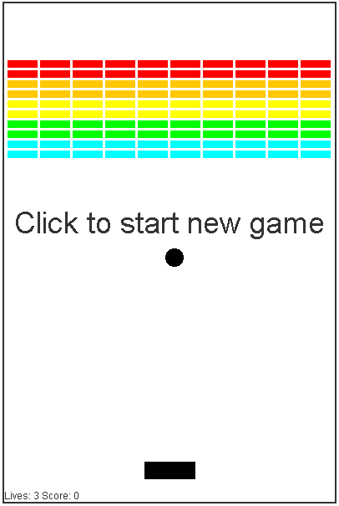
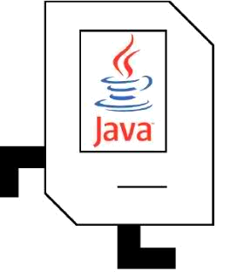
Life After The ACM Libraries
All quarter we have relied on the ACM Java libraries.
Karel, ConsoleProgram, RandomGenerator
GraphicsProgram, GOval, GRect, GOval, GLine, GImage, ...
Today we will see how standard Java programs are made.

Slide 8
Using the ACM Libraries
import acm.program.*;
public class MyProgram extends ConsoleProgram {
public void run() {
println("Hello, world!");
}
}
This is a console program written using the ACM libraries.
It uses the ConsoleProgram class to represent a console.
The run method contains the program code.
The println method prints output to the graphical console.

Slide 9
Pulling Back The Covers
MyProgram program = new MyProgram();
...
program.init();
...
program.run();
...

Slide 10
Pulling Back The Covers
public static void main(String[] args) {
MyProgram program = new MyProgram();
program.init();
program.run();
}

Slide 11
A Barebones Java Program
public class Hello {
public static void main(String[] args) {
System.out.println("Hello, world!");
}
}
The method main is the true entry point for a Java program.
It must have the exact heading shown above.
The String[] args are "command line arguments" (ignored).
The println command's true name is System.out.println.
Standard Java methods are static unless part of a class of objects.

Slide 12
Console Programs
What does the ConsoleProgram library class do?
Creates a new graphical window
Puts a scrollable text area into it
Provides print and println commands to send text output to that window
contains a main method that calls your program class's run method
ConsoleProgram's run is empty, but you extend and override it
public class Hello extends ConsoleProgram {
public void run() {
println("Hello, world!");
}
}

Slide 13
ACM console input
public class Age extends ConsoleProgram {
public void run() {
String name = readLine("What's your name? ");
int age = readInt("How old are you? ");
int years = 65 - age;
println(name + " has " + years
+ " years until retirement!");
}
}
The ACM library has simple console input commands like readLine, readInt, readDouble, and so on.
These methods display a 'prompt' message, wait for input, re-prompt if the user types a bad value, and return the input.

Slide 14
Java console input
public class Age {
public static void main(String[] args) {
Scanner console = new Scanner(System.in);
System.out.print("What's your name? ");
String name = console.nextLine();
System.out.print("How old are you? ");
int age = console.nextInt();
int years = 65 - age;
System.out.println(name + " has " + years
+ " years until retirement!");
}
}
In standard Java, you must create a Scanner or similar object to read input from the console, which is also called System.in.
It does not automatically re-prompt and can crash on bad input.

Slide 15
Graphics Programs
The ACM library does several things to make graphics easier:
Automatically creates and displays a window on the screen.
In standard Java, we must do this ourselves; it is called a JFrame.
Sets up a drawing canvas in the center of the window In standard Java, we must create our own drawing canvas.
Provides convenient methods to listen for mouse events.
In standard Java, event handling takes a bit more code to set up.

Slide 16
ACM GUI example
public class ColorFun extends Program {
public void init() {
JButton button1 = new JButton("Red!");
JButton button2 = new JButton("Blue!");
add(button1, SOUTH);
add(button2, SOUTH);
addActionListeners();
}
public void actionPerformed(ActionEvent event) {
if (event.getActionCommand().equals("Red!")) {
setBackground(Color.BLUE);
} else {
setBackground(Color.RED);
}
}
}

Slide 17
Java GUI example
public class ColorFun implements ActionListener {
public static void main(String[] args) {
new ColorFun().init();
}
private JFrame frame;
public void init() {
frame = new JFrame("ColorFun");
frame.setSize(500, 300);
JButton button1 = new JButton("Red!");
JButton button2 = new JButton("Blue!");
button1.addActionListener(this);
button2.addActionListener(this);
frame.add(button1, "South");
frame.add(button2, "South");
frame.setVisible(true);
}
public void actionPerformed(ActionEvent event) {
if (event.getActionCommand().equals("Red!")) {
frame.setBackground(Color.BLUE);
} else {
frame.setBackground(Color.RED);
} } }

Slide 18
Summary
Benefits of libraries:
simplify syntax/rough edges of language/API
avoid re-writing the same code over and over
possible to make advanced programs quickly
leverage work of others
Drawbacks of libraries:
learn a "dialect" of the language ("ACM Java" vs. "real Java")
lack of understanding of how lower levels or real APIs work
some libraries can be buggy or lack documentation
limitations on usage; e.g. ACM library cannot be re-distributed for commercial purposes

Slide 19
Plan for today
Announcements
Life after the ACM Libraries
Life after Java
Life after PC programs
Internet applications
Mobile applications

Slide 20
Programming Languages

Slide 21
Programming Languages
https://imgs.xkcd.com/comics/standards.png

Slide 22
Java
ArrayList<Double> evens = new ArrayList<>();
for(int i = 0; i < 100; i++) {
if(i % 2 == 0) {
evens.add(i);
}
}
println(evens);
prints [2, 4, 6, 8, 10, 12, … ]

Slide 23
C++
Vector<double> evens;
for(int i = 0; i < 100; i++) {
if(i % 2 == 0) {
evens.add(i);
}
}
cout << evens << endl;
prints [2, 4, 6, 8, 10, 12, … ]

Slide 24
Python
evens = []
for i in range(100):
if i % 2 == 0:
evens.append(i)
print evens
prints [2, 4, 6, 8, 10, 12, … ]

Slide 25
Javascript
var evens = []
for(var i = 0; i < 100; i++) {
if(i % 2 == 0) {
evens.push(i)
}
}
console.log(evens)
prints [2, 4, 6, 8, 10, 12, … ]

Slide 26
Plan for today
Announcements
Life after the ACM Libraries
Life after Java
Life after PC programs
Internet applications
Mobile applications

Slide 27
Programs and the Internet
How does your phone communicate with Facebook?

Slide 28
Programs and the Internet
The Java program on your phone talks to the Java program at Facebook.

Slide 29
Facebook
Facebook Server
* Android phones run Java. So do Facebook servers!

Slide 30
Facebook
Facebook Server
Is this login ok?
troccoli@stanford.edu
Confirmed. troccoli@stanford.edu is now logged in.

Slide 31
Facebook
Facebook Server
Send me the full name for troccoli@stanford.edu
Nick Troccoli
“Nick Troccoli”

Slide 32
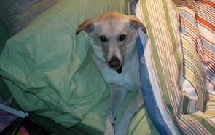
Facebook
Facebook Server
Send me the cover photo for troccoli@stanford.edu
Nick Troccoli

Slide 33
Programs and the Internet
There are two types of internet programs: clients and servers.

Slide 34
Programs and the Internet
Clients send requests to servers, who respond to those requests.

Slide 35
Servers Are Computer Programs!
Facebook Server
=

Slide 36
Servers
Request
someRequest
String
serverResponse
Server

Slide 37
What is a Request?
/* Request has a command */
String command;
/* Request has parameters */
HashMap<String,String> params;

Slide 38
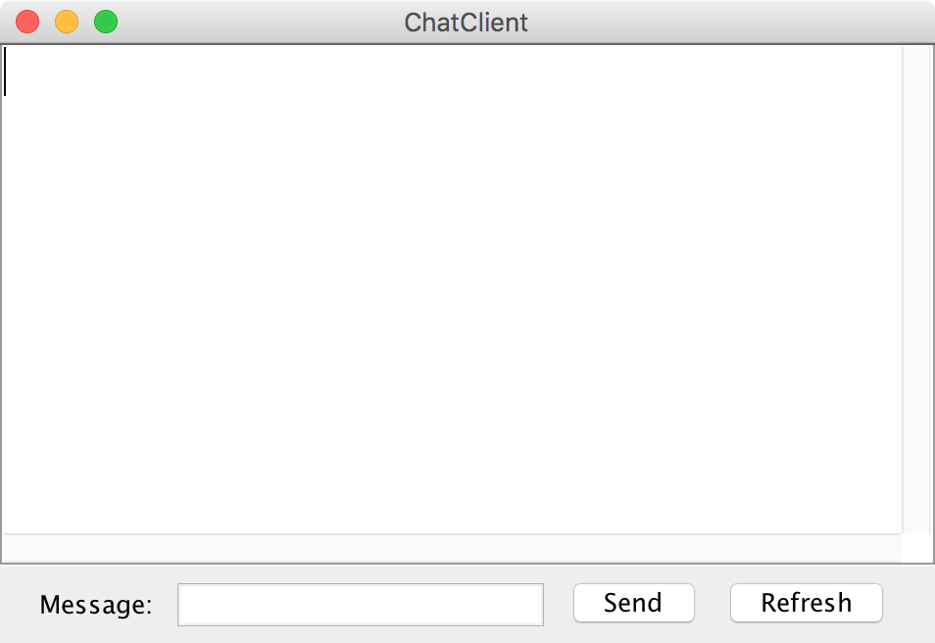
Clients
Chat Client
Chat Client
> Hello world
> Hello world
Send
Send

Slide 39
URL
http://4f39fd79.ngrok.io

Slide 40
Plan for today
Announcements
Life after the ACM Libraries
Life after Java
Life after PC programs
Internet applications
Mobile applications

Slide 41
Recap
Announcements
Life after the ACM Libraries
Life after Java
Life after PC programs
Internet applications
Mobile applications
Tomorrow: Intro to Machine Learning!

